Slide 1

Tor and Tor service
Onion routing
Nabhanyu Halgeri
Rushit Shah
Alka Singh Rathor

Slide 2

What is Tor and Tor Onion service

Slide 3

What is Tor
It is a project whose main objective is the development of a distributed communication network over laid on the Internet can which the routing of messages exchanged between users does not reveal the users identity.
How tall is voluntarily operated anonymity network that is estimated to protect the privacy of hundreds of thousands of users daily estimated about 800,000 to million users daily
toys operated to a number of organizations and individuals to donate their Internet bandwidth processing power and technical expertise

Slide 4

TOR continued
Online anonymous communication is made possible by the free and open-source programmed Tor (The Onion Router).
works by channeling internet traffic across a number of nodes operated by volunteers.
Used by people who want to evade censorship, surveillance, or tracking,
Most nations allow the use of Tor, but some, like China and Iran, have outlawed or severely limited it.
It is not impenetrable and is known to have various flaws, including browser fingerprinting and exit node attacks.

Slide 5

Why is it being used
Protect users from traffic analysis
users who do not want companies to market to them based on the browsing data
individuals who live in countries with censored Internet access journalists protecting their source.
Organization that want to keep their strategies confidential

Slide 6

Without tower a user's location can be tracked whenever he or she comes online the HTTP headers contain information about sports and destination along with time browser permission and cookies which allows a creation of and detailed profile.
Note tough doesn't anonymize one's identity but it anonymised their Internet traffic origination

Slide 7

How Tor Works
start network consists of a series of nodes and relays that communicates using TLS over TCP slash IP from one node to another

Slide 8

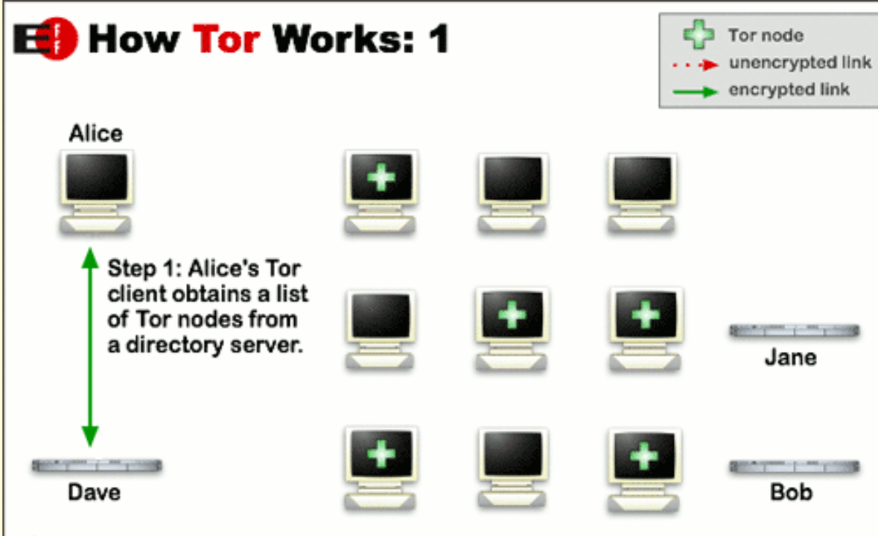

Slide 9
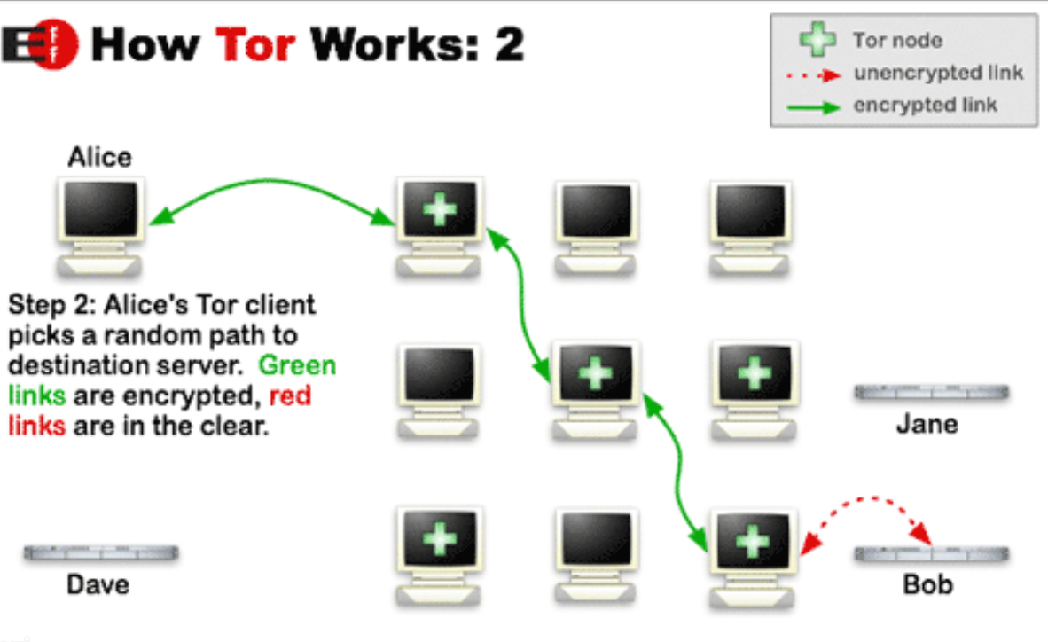

Slide 10
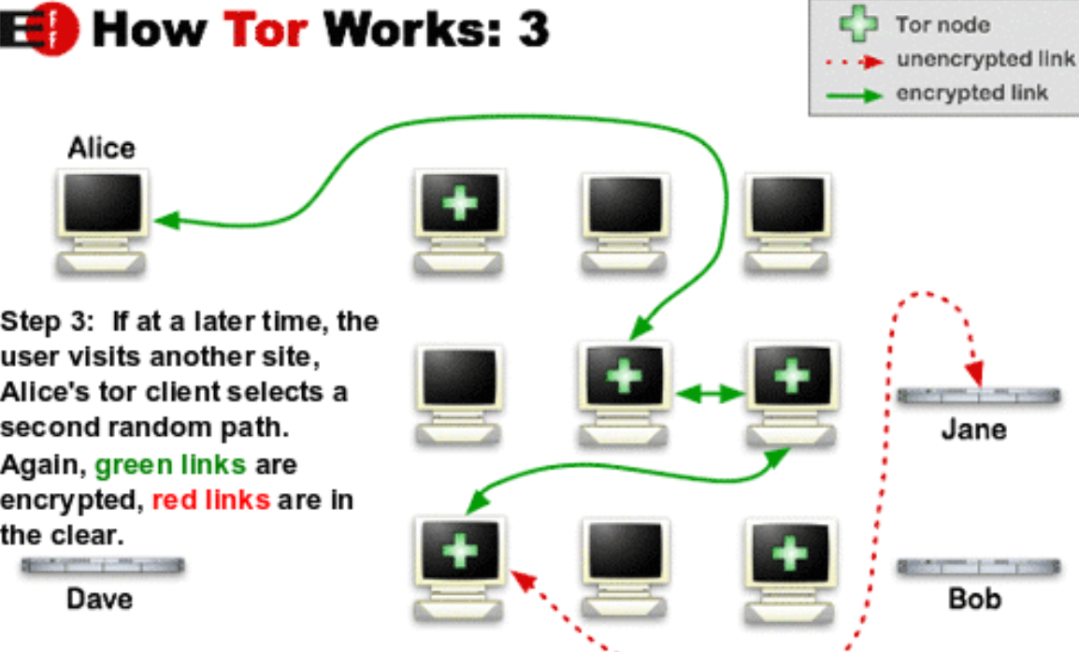

Slide 11

Tor is based on the concept of onion routing and onion routing is a method of consecutive clearing of encryption that can be peeled back as it passes through a series of proxy systems.
Each layer peels or decrypts information on to send next with the original message being known to the sender the exit node and the recipient.

Slide 12
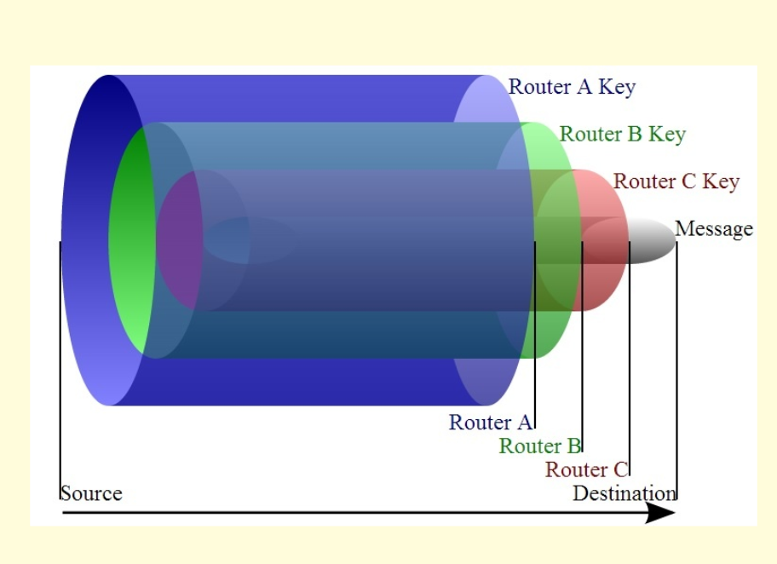
Multilayering of the network traffic

Slide 13

How safe is Tor
Exit notes can be snapped volunteer operators of an exit relay could real all your communications
HTTP clearly visible to the exit relay only
https vulnerabilities that includes SSL striping Heartbleed which is open SSL vulnerability

Slide 14
Can Tor be de-anonymity
A simple JavaScript can lead your IP address
browser plugins can leak ones IP address,
Browser cookies email meta data Adobe Flash Microsoft metadata
BitTorrent reveals IP
botnet and malware like win 32 Trojan horses etc.

Slide 15

How feasible it is to crack down
in theory all the notes of star can be de anonymised but with millions of nodes being maintained by voluntary organisations and people New notes can resurface in moments time the others have been de anonymised or taken down.

Slide 16

Types of attack on Tor

Slide 17
Fill up on Tow attacks

Slide 18

Implementation -1
Creating of a website running on hidden service of onion locally

Slide 19
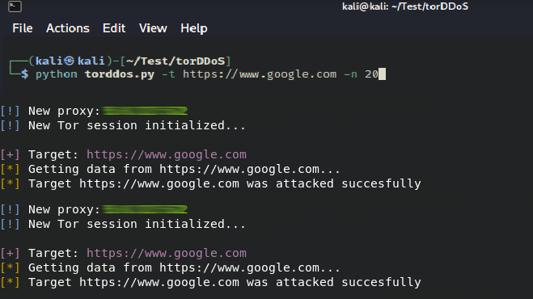
DOS attack in action

Slide 20

Implementation -2
Torbrowser.exe

Slide 21
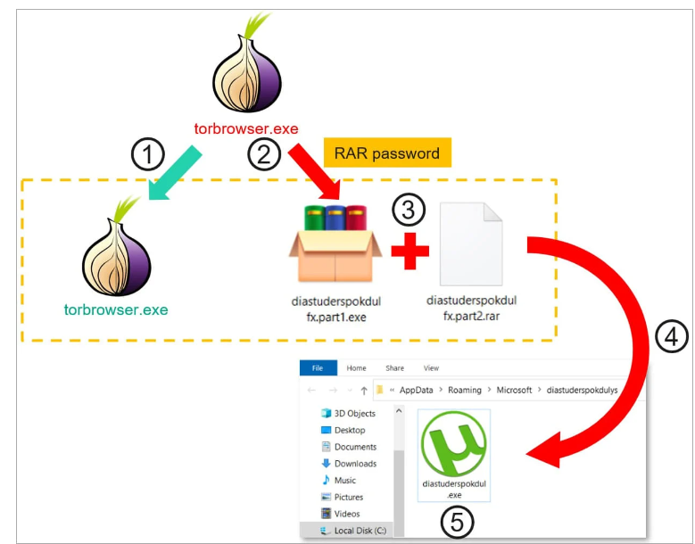
Embeded

Slide 22
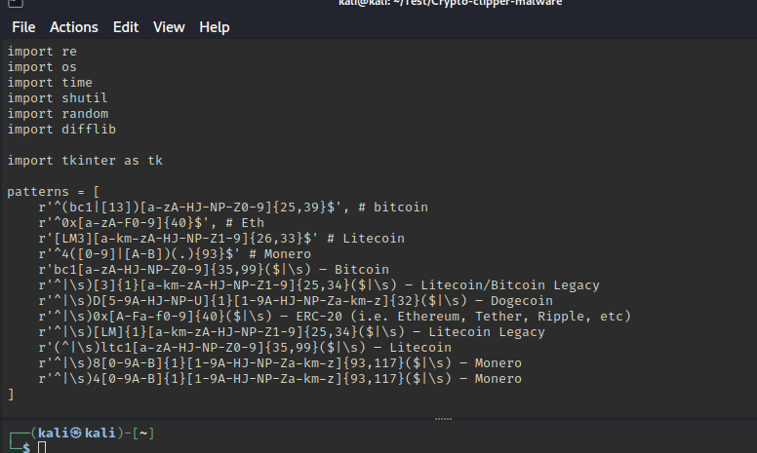
Clipboard malware

Slide 23
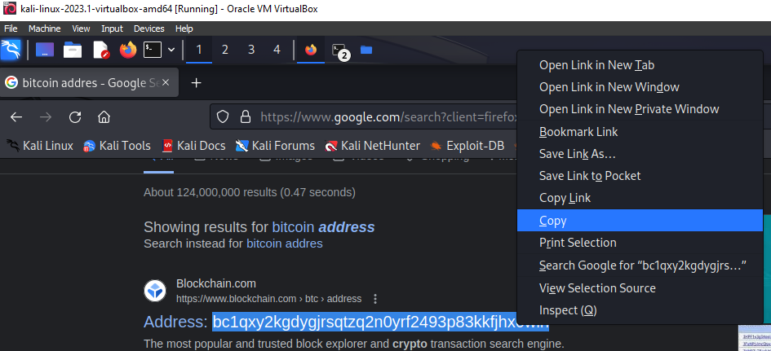

Slide 24
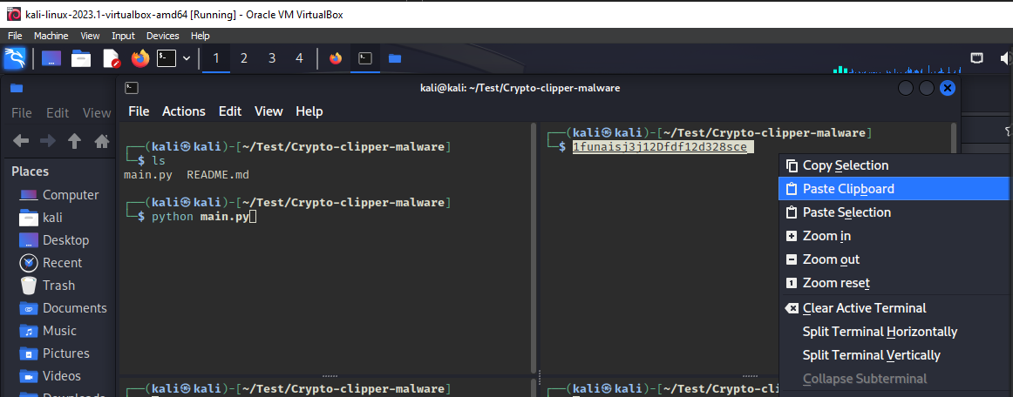

Changing the address to the attackers address

Slide 25

Thanks You
Questions

